Slide 1
Examining Brand Perception Challenges: VADER Approach vs. Traditional Analysis for Improved Understanding
TEAM MEMBERS
VIDHIYA S B (210701306)
VAISHARLI S (210701296)

Slide 2
ABSTRACT
In today’s digital era , Social media plays a key role in Brand’s reputation and perception. Using a Data driven approach, It is easier to analyze the brand’s public review and where it stands among all the organizations. It helps the brand to understand and analyze their position and helps them improve their brand. Sentiment Analysis is one of the NLP techniques used to analyze positivity, Negativity or neutrality of a data, which helps in accurate brand perception. It is impossible for an individual to check lakhs and lakhs of comments on social media and it is difficult to analyze the reputation of the brand among the public. This paper focuses on VADER (Valence Aware Dictionary and Sentiment Reasoner). classification which is a tool used for Sentiment Analysis within NLTK. VADER is a lexicon oriented sentiment analysis tool which can be used to analyze the customer reviews which are all over on the social media which can be uploaded as a csv to the User Interface and the user can understand how customers perceive a particular brand. The reviews are combined to know the overall sentiment distribution (positive , negative or neutral) and the pie chart shows the sentiment distribution of a brand. The line chart combines the text data according to the month they were created. The text data without stop words are visualized using word clouds and suggestions are generated using distil-gpt2.

Slide 3
INTRODUCTION
Brand perception analysis plays a crucial role in evaluating public reviews of a product or service offered by an organization. Social media, especially platforms like Twitter, significantly aids in data collection due to the brevity and frequency of tweets, which are limited to 148 characters, making them easier to analyze. This data collection approach allows us to gauge a product's worth and brand quality from a commoner's perspective. For e-commerce platforms, understanding customer sentiment through this method helps improve product recommendations and optimize overall recommending strategies. Additionally, organizations can assess their market position by understanding customer satisfaction levels. This methodology extends to the entertainment industry, enabling media companies, movie studios, and music labels to gauge audience sentiment about their content and analyze its popularity. Employing DistilGPT2, a distilled version of the GPT-2 model, to generate human-like text suggestions based on negative reviews, businesses can swiftly identify and address key issues. This approach enhances customer engagement by providing constructive feedback efficiently. Automating the suggestion generation process empowers businesses to respond to feedback promptly, fostering a culture of continuous improvement and customer-centric innovation.

Slide 4
LITERATURE REVIEW
S.NO | TITLE | AUTHOR | YEAR | ADVANTAGES | DISADVANTAGES
1. | Natural Language Processing: A Quick Introduction to NLP with Python and NLTK. | S. Burns | 2019 | Easy to understand introduction to NLP concepts | Limited depth for experienced users
2. | The Influence of Online Social and Physical Presence on User Consumption Decisions in TikTok Livestreaming: A Scoping Review | K. Bai & K. H. Tan | 2024 | Recent findings on user behavior in TikTok | Limited scope (overview, not in-depth analysis)
3. | Beginner’s Guide to Streamlit with Python: Build Web-Based Data and Machine Learning Applications. | S. Raghavendra | 2023 | Practical guide for building web apps with Streamlit | May not cover advanced Streamlit features
4. | Application of sentiment and word frequency analysis of physician review sites to evaluate refractive surgery care | V. Vought et al. | 2024 | Shows sentiment analysis in a real-world application | - Limited to specific field (refractive surgery)
5. | Natural Language Processing With Python: Natural Language Processing Using NLTK. | F. Millstein | 2020 | Focuses on NLTK library for NLP tasks | May not cover broader NLP advancements

Slide 5
LITERATURE REVIEW
S.NO | TITLE | AUTHOR | YEAR | ADVANTAGES | DISADVANTAGES
6. | Multimodal Sentiment Analysis | S. Poria et al. | 2018 | Analyzes sentiment beyond just text data | Might be challenging for beginners
7. | Sentiment Analysis of Animated Film Reviews Using Intelligent Machine Learning | C. Chen et al. | 2022 | Uses machine learning for sentiment analysis | Lacks details on specific machine learning methods
8. | Deep Learning: Research and Applications | S. Bhattacharyya et al. | 2020 | Comprehensive overview of deep learning concepts | - May be more theoretical than practical
9. | Pytheas: pattern-based table discovery in CSV files. | Christodoulakis et al. | 2020 | Automates table extraction from CSV files | May struggle with complex or irregular table formats
10. | Supervised machine learning models for depression sentiment analysis | I.C. Obagbuwa et al. | 2023 | Uses machine learning to potentially detect depression | Requires access to sensitive data (depression labels)

Slide 6
RESEARCH GAPS
Cheng Chen, Bin Xu , Jong-Hoon Yang, and Mi Liu did a project called “Sentiment analysis of Animated Film reviews using Intelligent Machine Learning”. This project aims to analyze the sentiment of users towards the animated movie, the dataset which is used to train the model is collected from various users by analyzing their behavior. Even in a social media or e-commerce platform uses the information of the users browsing history, customers favorites, add-ons, most viewed content and liked content based on this the recommendation of a content for a user is done. This paper focused on the construction of several deep learning models, intelligent machine learning-based text sentiment classification. These models were compared based on their experimental results and methods. This analysis towards the movie only achieves the overall sentiment of the review data and fails to analyze the specific context in the movie, specifically plot, special effects and content of the movie.

Slide 7
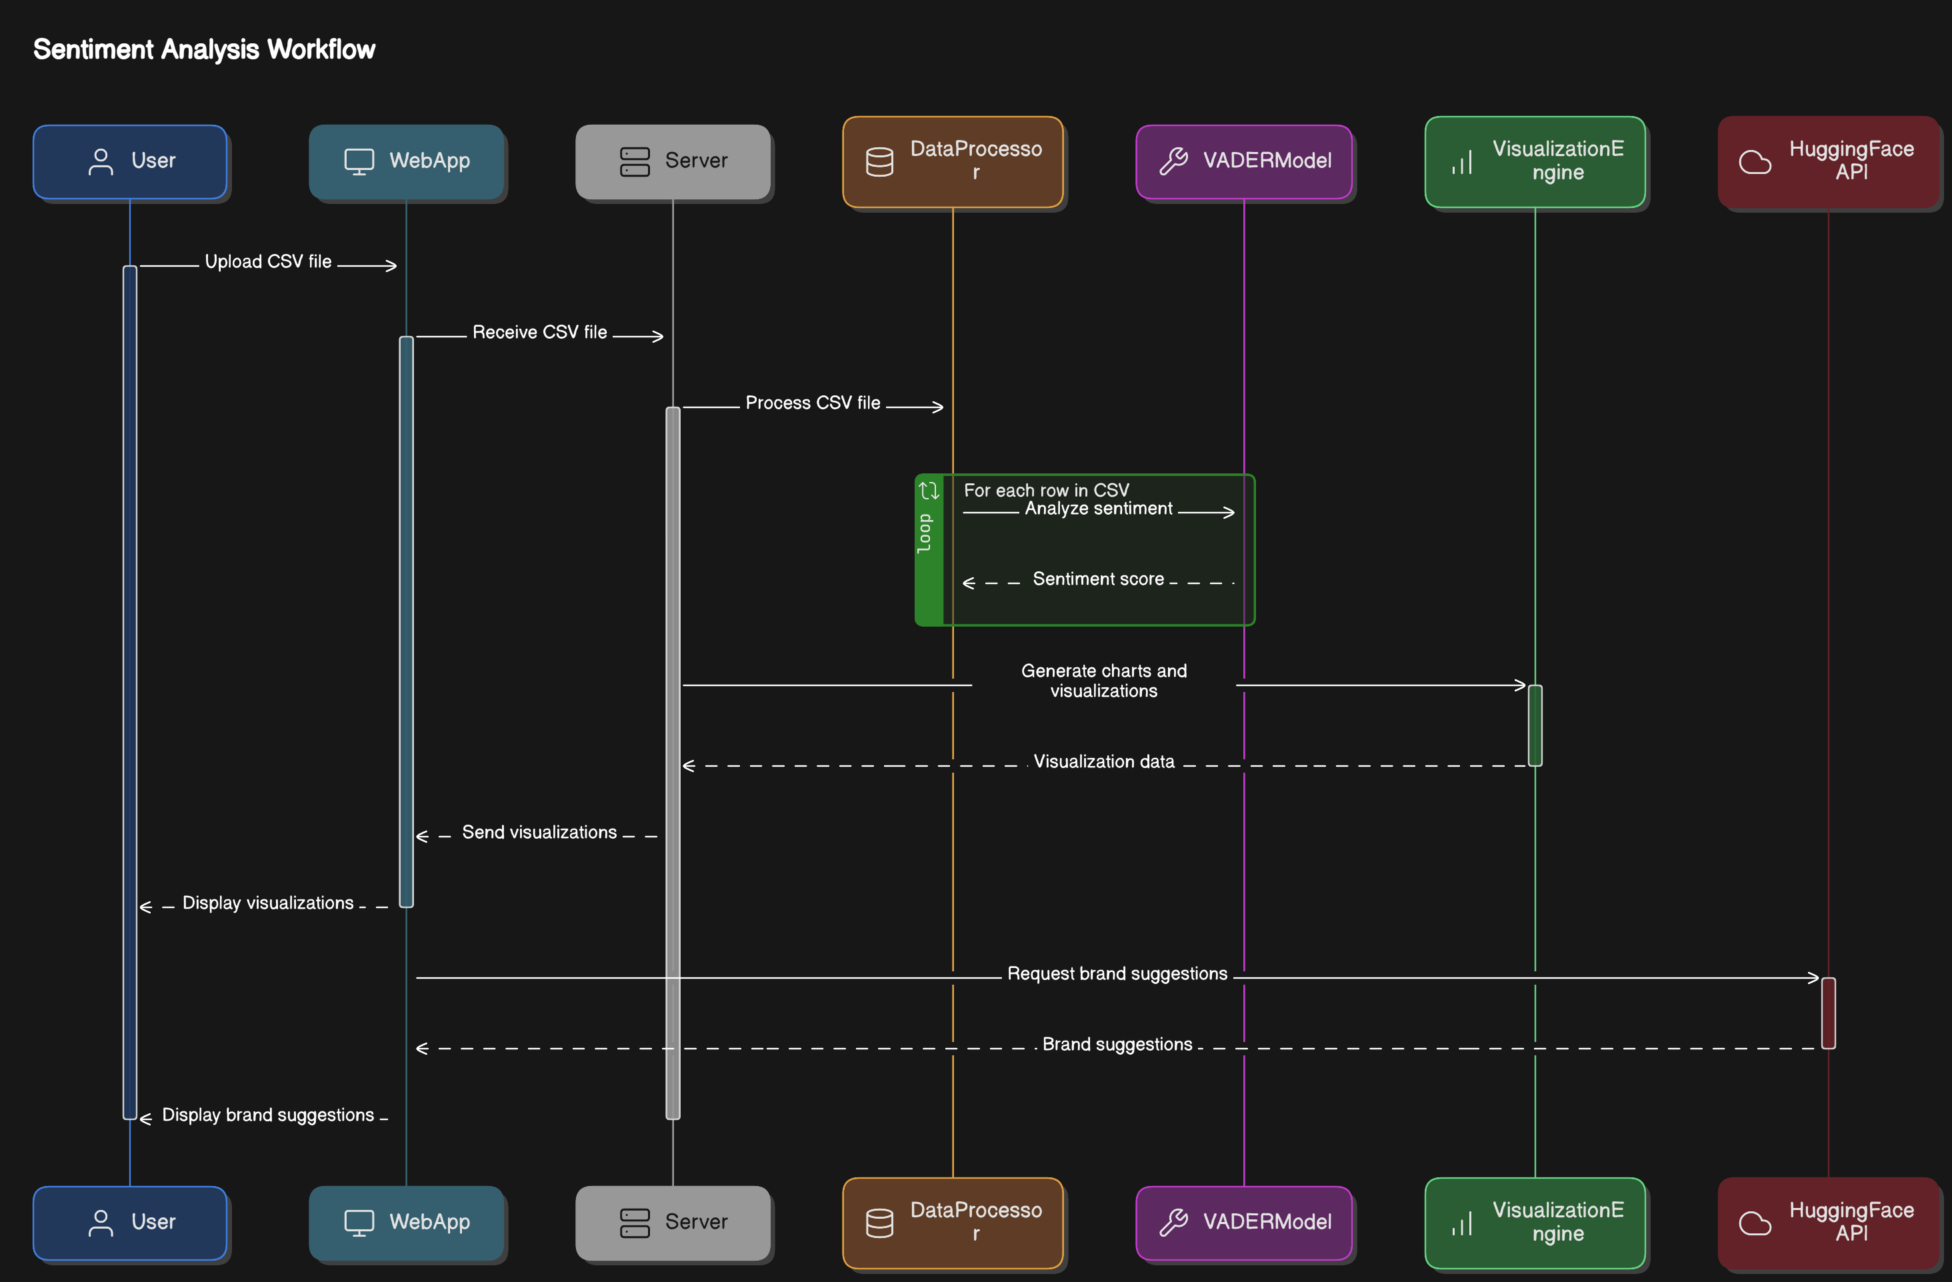
PROPOSED METHODOLOGY

Slide 8
RESULTS AND DISCUSSION
Using VADER, the sentiment analysis module accurately classified customer reviews into positive, negative, and neutral categories. The sentiment distribution was visualized through pie charts, offering a clear representation of customer sentiments towards different brands. The analysis revealed that the majority of reviews for certain brands were predominantly positive, indicating high customer satisfaction. However, for some brands, a notable percentage of negative reviews was observed, highlighting areas requiring attention. The word clouds generated for positive and negative reviews further provided valuable insights into frequently mentioned terms and common themes, helping to identify specific aspects of products or services that customers appreciated or found problematic.

Slide 9
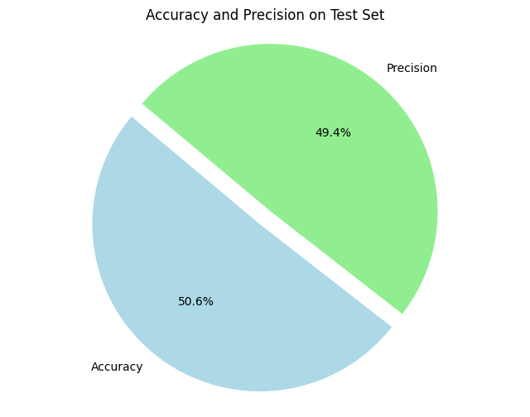
RESULT

Slide 10
RESULT
The integration of VADER and DistilGPT2 into a single platform has proven to be an effective approach for sentiment analysis and suggestions generation. The use of VADER allowed for quick and accurate sentiment scoring, which is essential for understanding customer perceptions at scale. DistilGPT2’s text generation capabilities added a proactive dimension to the feedback analysis process, enabling brands to receive concrete improvement suggestions derived directly from customer feedback.
One of the key strengths of this system is its ability to process large volumes of textual data efficiently, providing real-time insights and recommendations. This is particularly valuable for businesses operating in competitive markets where timely responses to customer feedback can significantly impact customer satisfaction and brand loyalty. The visualizations further enhance the interpretability of the data, making it easier for businesses to grasp sentiment trends and prioritize actions accordingly.

Slide 11
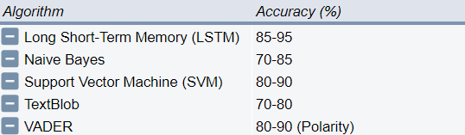
COMPARATIVE ANALYSIS

Slide 12
CONCLUSION
The implementation of VADER for sentiment analysis and DistilGPT2 for text generation within this project has shown significant potential in enhancing brand reputation management and customer feedback analysis. Leveraging these advanced NLP tools, the system processed vast amounts of customer reviews, classified sentiments accurately, and generated actionable improvement suggestions. Integrating sentiment analysis and text generation within a unified platform provides comprehensive insights into customer perceptions, enabling proactive concern addressing and product enhancement. Visualization components, like sentiment distribution pie charts and word clouds, facilitate data interpretation, helping businesses grasp sentiment trends and prioritize actions. Automating sentiment analysis and generating visual representations allows businesses to stay attuned to real-time feedback, identify trends, and address issues promptly. Using DistilGPT2 for improvement suggestions based on negative reviews adds a proactive dimension to customer relationship management, enhancing satisfaction and loyalty. This approach demonstrates the value of advanced NLP technologies in providing deeper insights and significant value across various

Slide 13
FUTURE ENHANCEMENTS
While the project has shown substantial benefits, several enhancements can further extend its capabilities. Incorporating NLP models like BERT or RoBERTa could improve sentiment analysis accuracy by providing better context understanding. A multi-lingual sentiment analysis module would handle reviews in various languages, broadening global applicability. Developing a robust feedback loop for continuous learning from new data can enhance accuracy and relevance. Advanced data preprocessing, such as Named Entity Recognition, can provide granular insights. Enhancing UI/UX with customizable visualizations would make the tool more user-friendly. Integrating with other data sources, such as social media and customer service logs, offers a holistic view of brand sentiment. Ensuring scalability and security with cloud infrastructure and robust privacy measures will maintain efficiency and compliance.

Slide 14
REFERENCES
[1] S. Burns, Natural Language Processing: A Quick Introduction to NLP with Python and NLTK. 2019.
[2] K. Bai and K. H. Tan, “The Influence of Online Social and Physical Presence on User Consumption Decisions in TikTok Livestreaming: A Scoping Review,” Cyberpsychol. Behav. Soc. Netw., May 2024, doi: 10.1089/cyber.2023.0526.
[3] S. Raghavendra, Beginner’s Guide to Streamlit with Python: Build Web-Based Data and Machine Learning Applications. 2023.
[4] V. Vought, R. Vought, A. S. Lee, I. Zhou, M. Garneni, and S. A. Greenstein, “Application of sentiment and word frequency analysis of physician review sites to evaluate refractive surgery care,” Adv Ophthalmol Pract Res, vol. 4, no. 2, pp. 78–83, Mar. 2024.

Slide 15
REFERENCES
[5] F. Millstein, Natural Language Processing With Python: Natural Language Processing Using NLTK. Frank Millstein, 2020.
[6] S. Poria, A. Hussain, and E. Cambria, Multimodal Sentiment Analysis. 2018.
[7] C. Chen, B. Xu, J.-H. Yang, and M. Liu, “Sentiment Analysis of Animated Film Reviews Using Intelligent Machine Learning,” Comput. Intell. Neurosci., vol. 2022, p. 8517205, Jul. 2022.
[8] S. Bhattacharyya, V. Snasel, A. E. Hassanien, S. Saha, and B. K. Tripathy, Deep Learning: Research and Applications. Walter de Gruyter GmbH & Co KG, 2020.

Slide 16
REFERENCES
[9] Christodoulakis, Christina, et al. "Pytheas: pattern-based table discovery in CSV files." Proceedings of the VLDB Endowment 13.12 (2020): 2075-2089.
[10] I. C. Obagbuwa, S. Danster, and O. C. Chibaya, “Supervised machine learning models for depression sentiment analysis,” Front Artif Intell, vol. 6, p. 1230649, Jul. 2023.

